Slide 1


Slide 2
Introduction to Data Management
Dylan Valerio
itstherealdyl.com
github.com/krsnewwave
medium.com/@dylanvalerio

Slide 3
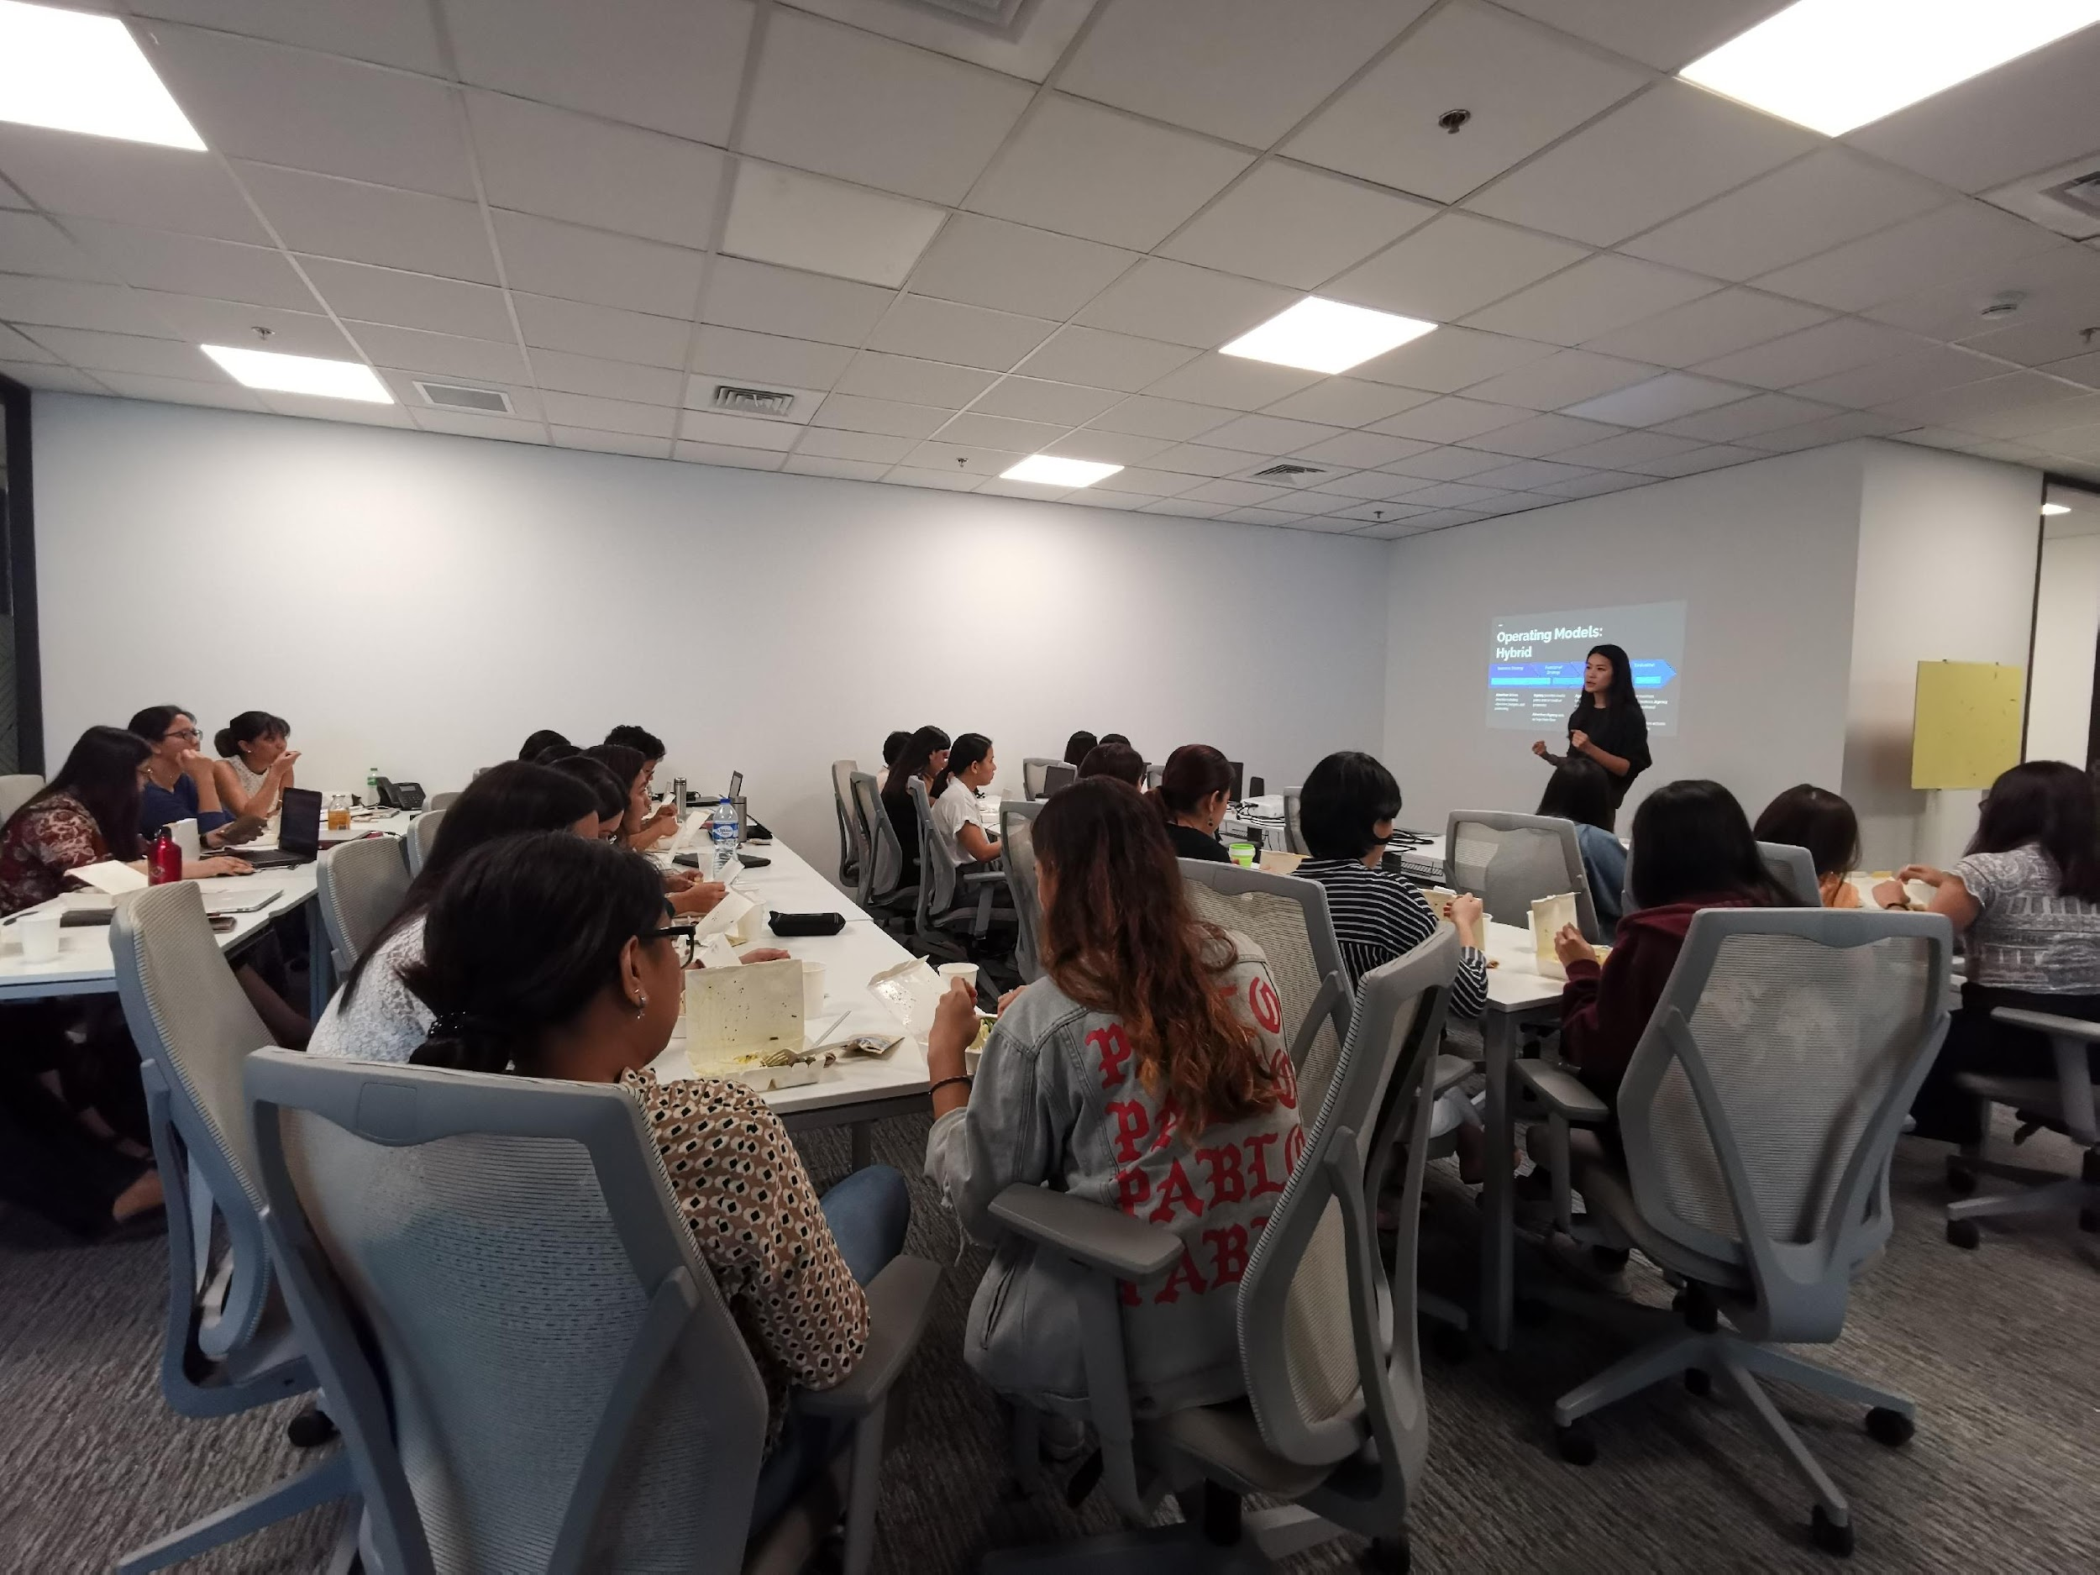

Icebreaker
Which SQL statement is your favorite?
Notes:
Serious: Case - When is very useful in data cleaning
Silly: DISTINCT, because even if you group me with others, I’m always unique

Slide 4
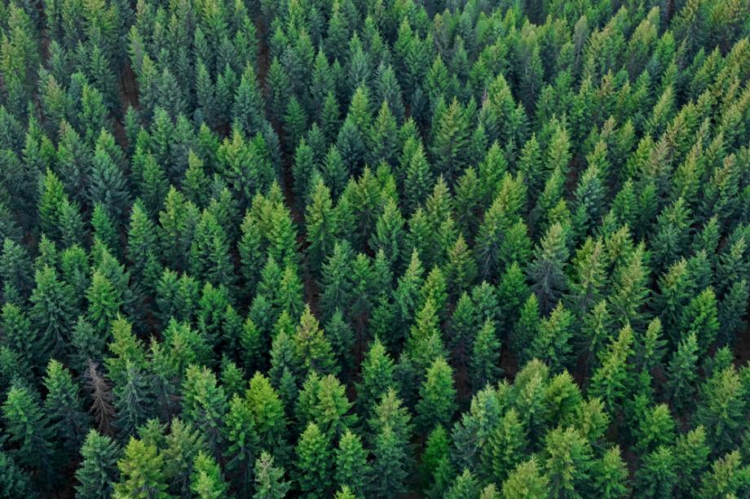
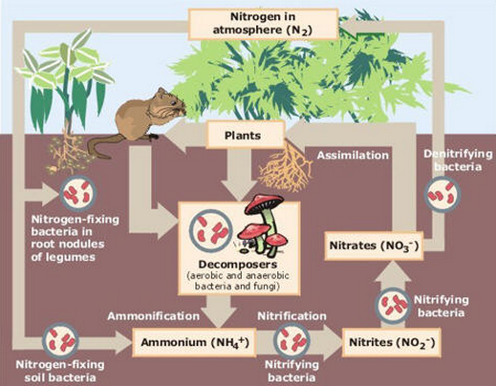

INTRODUCTION
DATA AS AN ARTIFACT
DATA AS A JOURNEY
DATA MANAGEMENT MILESTONES
Notes:
Nature metaphors – so data doesn’t sound too artificial, impersonal, or unnatural :)
Artifact - large forests, amazing and daunting
Journey - intricate systems to generate and use it
Milestones - Stop and smell the flowers

Slide 5
Data as an Artifact
A forest of trees is a spectacle too much for one man to see.

Slide 6

DATA AS AN ARTIFACT
Data is a precious thing and will last longer than the systems themselves.
Tim Berners-Lee, an inventor of the WWW

Slide 7
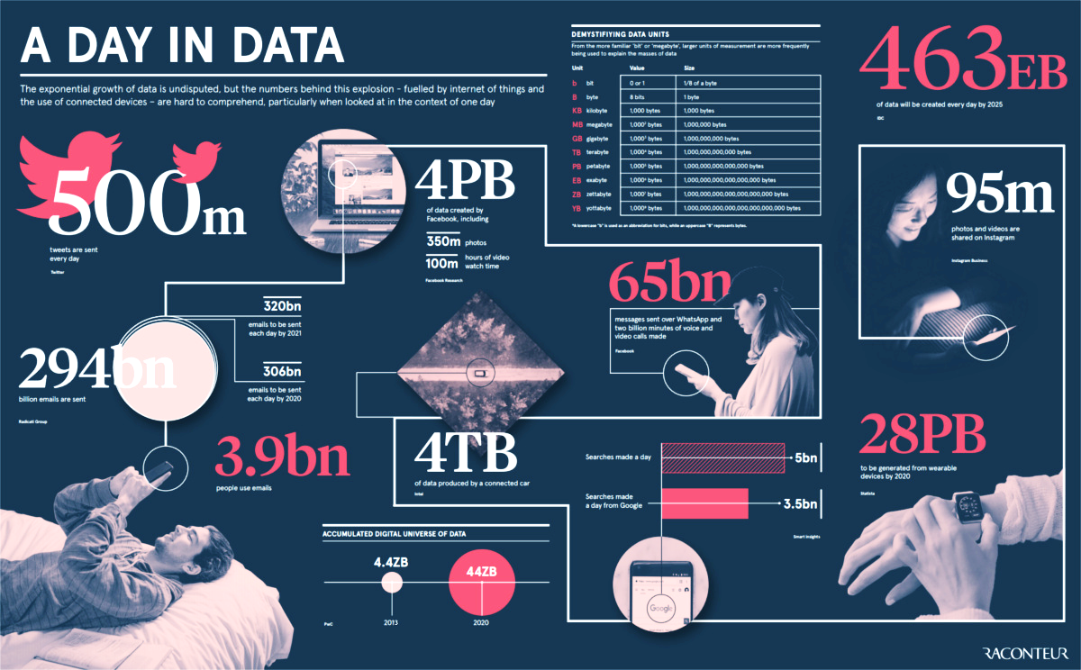
DATA AS AN ARTIFACT
https://www.visualcapitalist.com/how-much-data-is-generated-each-day/
Notes:
Data is significantly larger than the apps that spawned them

Slide 8

DATA AS AN ARTIFACT
Financials
Demographics
Text, Images, Audio, Video
What others can you think of?
Clicks
Scientific Data

Slide 9



DATA AS AN ARTIFACT
Structured & Unstructured
Tables, Text, Images
Small to Big
Surveys, purchases, genes
1 2.0
F, M
Numerical & Nominal
Integers, numbers, categories, orders
Public & Private
Academic, open-data, commercial, personal
Notes:
Orders - small, regular, large, XL

Slide 10


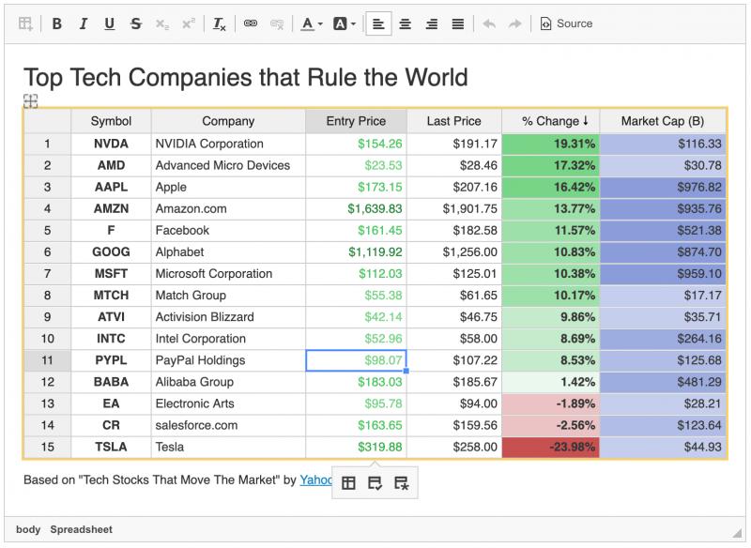
DATA AS AN ARTIFACT
Spreadsheets are one starting point
Databases allow for more flexibility and size
Data lakes allow for max flexibility and size
https://ckeditor.com/cke4/addon/spreadsheet
https://www.mysqltutorial.org/mysql-sample-database.aspx
Notes:
Allow for co-teacher to elaborate:
How data magnitude affects projects
How big data can still be messy (or even messier)
How to progress from spreadsheets to databases and even larger

Slide 11
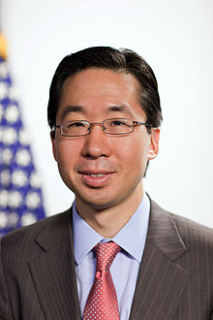
DATA AS AN ARTIFACT
Data by itself is useless. Data is only useful if you apply it.
Todd Park, former CTO of the USA

Slide 12
Data as a Journey
I took a walk in the woods and came out taller than the trees.

Slide 13
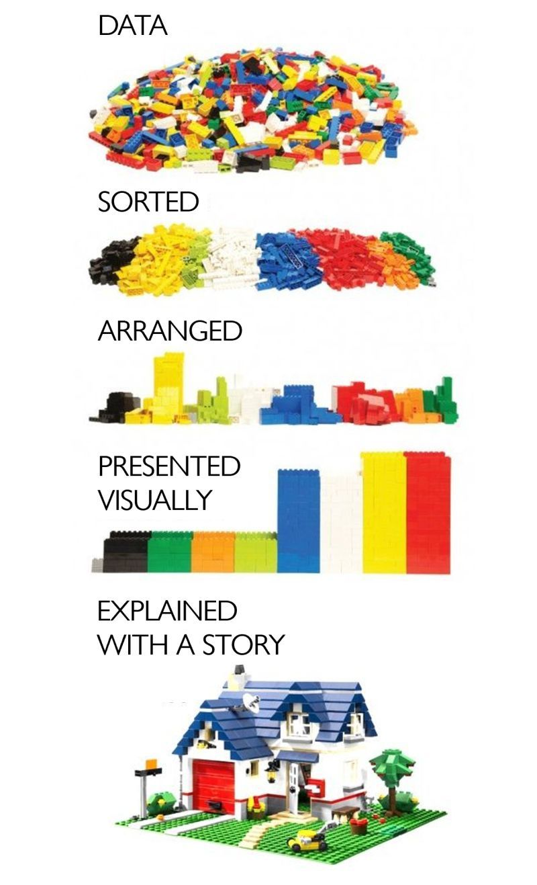
DATA AS A JOURNEY
Data is transformative
A mess of pieces can shape an organization’s future
A data strategy is vital
Repeated and agile = Win
A data-driven culture is key, from collection to use
https://www.linkedin.com/posts/andreasvonderheydt_the-difference-between-raw-data-and-the-stories-activity-6837751869125873664-beki/
Notes:
Great graphic
That data is transformative, also requires data to be transformed

Slide 14
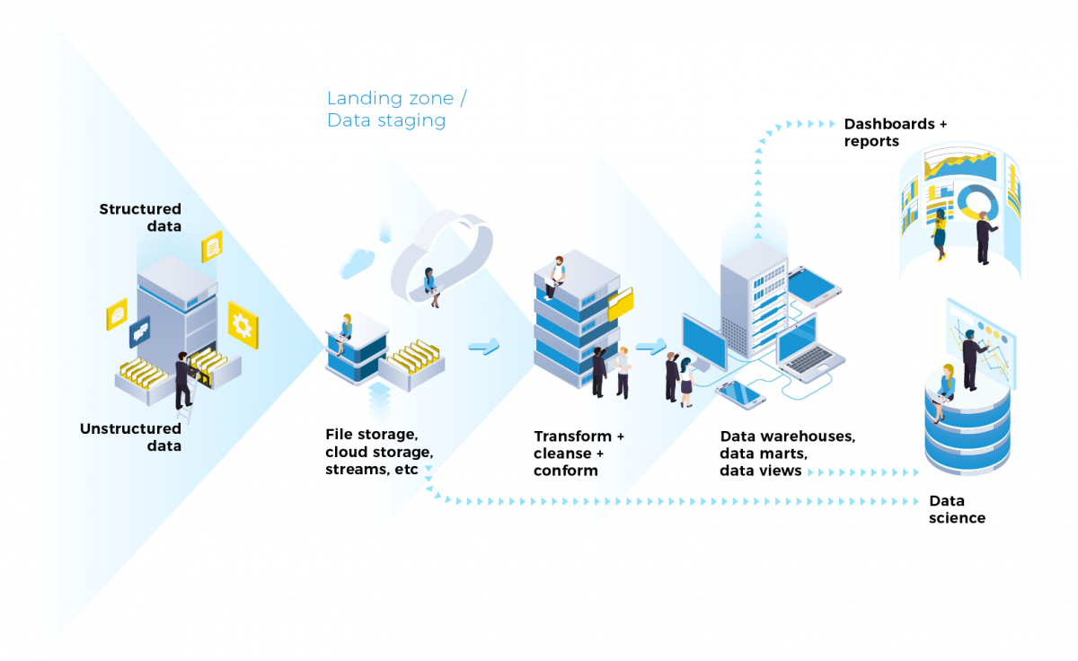
DATA AS A JOURNEY
Data pipelines are software systems that automates key parts of the data management process.
https://www.equalexperts.com/blog/our-thinking/what-is-a-data-pipeline/
Notes:
You’ll see pipelines are a lot in your career. You might even design one yourselves.

Slide 15
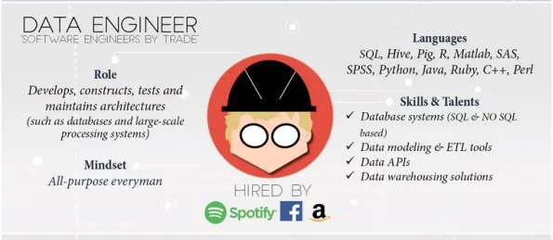
DATA AS A JOURNEY
Talk to the data engineers when automating the collection and storage part of your project.
https://makemeanalyst.com/who-is-big-data-engineer-and-how-to-become-a-big-data-engineer/

Slide 16
DATA AS A JOURNEY
SQL is the language across many industry platforms, with each having their own ‘dialect’ and special features.
DQL (Query)
SELECT
FROM
GROUP BY
DDL (Definition)
CREATE
ALTER
DROP
DML (Manipulate)
INSERT
UPDATE
DELETE
DCL (Control)
GRANT
REVOKE
Notes:
Where does SQL come in? All parts in the pipeline uses it.

Slide 17
Buzz Word
Data is the new oil?
No even better. It’s sustainable.

Slide 18
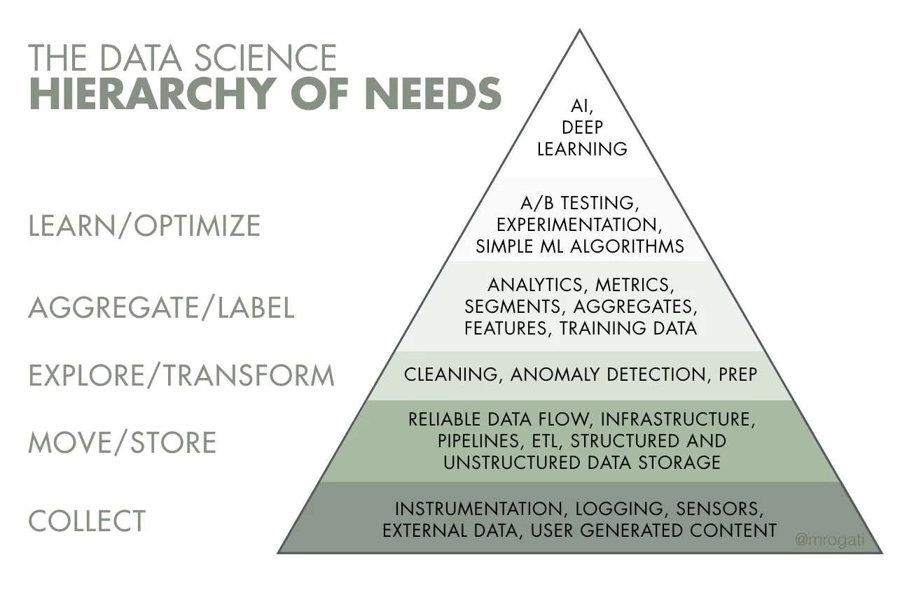
DATA AS A JOURNEY
Knowledge
actionable, impactful, sustainable
Information
summarized, visualized, retroactive
DATA
Raw, potential
https://hackernoon.com/the-ai-hierarchy-of-needs-18f111fcc007
Notes:
Data management is managing the foundations (first two)
The pyramid also shows how much time and resources are needed to support all the activities on top
For an org that is just starting their data journey, you will spend the first year managing the bottom activities – with a small win at the top.

Slide 19
DATA AS A JOURNEY
Just in the last work week, which part of the hierarchy were you working on?
https://hackernoon.com/the-ai-hierarchy-of-needs-18f111fcc007
Notes:
Allow for co-teacher to elaborate:
Also answer the question, which part of the hierarchy have you been working on
The AI, ML, DL hype

Slide 20
DATA AS A JOURNEY
The Data Lifecycle
Generation / Collection
Data is “born” and need to be collected and stored
Use
Processed data / information / knowledge is accessed by end user applications
Cleansing / Preparation
Once gathered, data needs to be “prepared” for use
Analysis / Processing
Data is transformed for use towards specific business problems
Sharing
Data is shared to users for reporting, analysis, or further collection

Slide 21
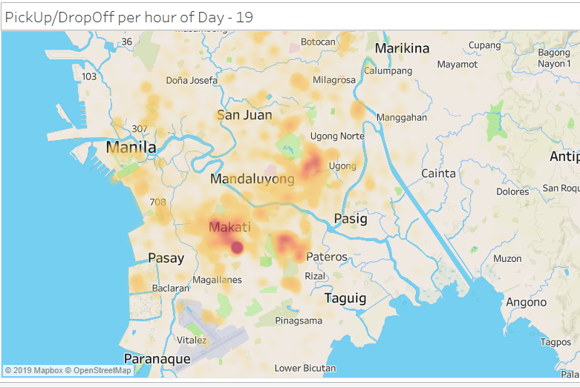
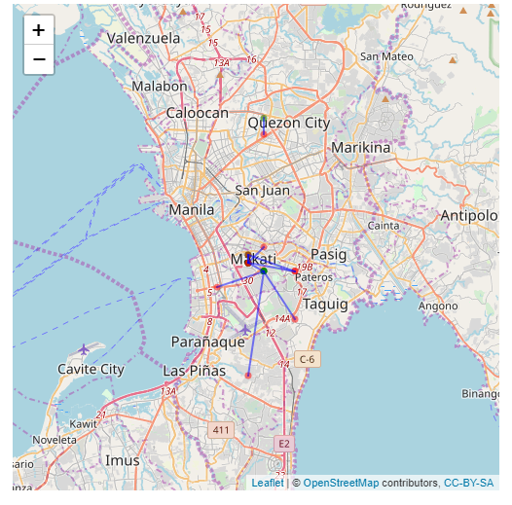
Where are the usual trips of Grab drivers?
What SQL commands would you use for this?

Slide 22
ACTIVITY
For each of the SQL statements on the right, think of a business question or objective that it addresses.
Use any of the following verticals. You may choose differently for each statement.
national healthcare system
ridesharing app
toy manufacturer
online course provider
Describe your thoughts to the group through a doc / sheet / slide
An actual SQL query is not necessary.
20 minutes prep & 15 minutes sharing
Select, between
Select count, where, order by
Select sum, group by, having
Left Join / Inner join
Union
A query that needs a subquery
Notes:
Business questions!

Slide 23
Data Management Milestones
Stop and smell the flowers

Slide 24

Data Management comprises all disciplines related to managing data as a valuable resource.

Slide 25
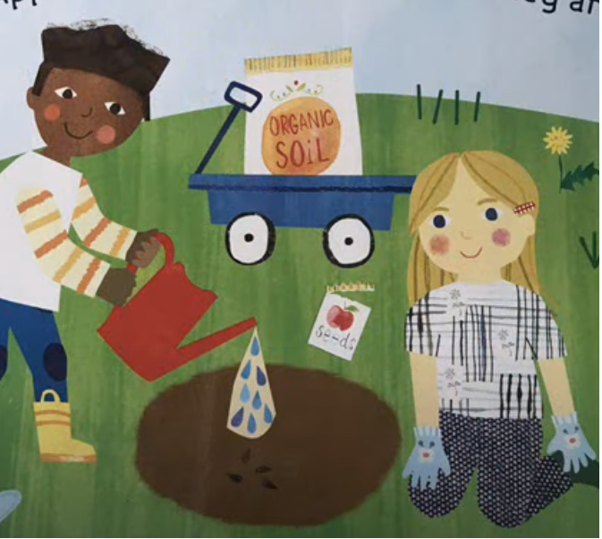




Data as it grows in value
A Data Management Metaphor
Collection
Storage
Quality
Governance
Consumption
From "How Do Apples Grow" by Jill McDonald
Notes:
Collection - just raw potential.
Storage - you’re starting to see roots and a sturdy trunk, but it’s still useless.
Quality - it looks beautiful and there’s already some value here
Governance - now we have fruit-bearing trees and we take care of it
Consumption - delivery!
And every time we have a new project, we just revisit our trees

Slide 26
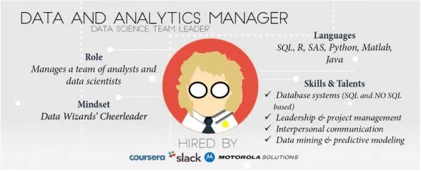
MILESTONES: Value
Where is the value?
Are the outcomes valuable?
Is the project feasible?
Skills, technologies, executive support
What data is needed?
Failure is likely if the value is vague, the data is non-existent, and the feasibility is artificial.
https://makemeanalyst.com/how-to-become-a-data-manager-how-to-get-into-data-manager-job-role/

Slide 27
MILESTONES: Collection
If the data exists, where is it generated / captured so we can collect them?
Traditional
Observations
Tests
Surveys
Documents
Corporate
Point of Sale
Inventory Systems
HR systems
Internet Proxy
Edge Sensors
Weather balloons
ID scanners
CCTV cameras
Home internet routers
BONUS: External Data
Government Websites
Yellow Pages
Twitter
Data sellers ie. Nielsen
Notes:
Allow for co-teacher to elaborate. What are the most unique data points you have encountered? (free of NDA, :D)

Slide 28
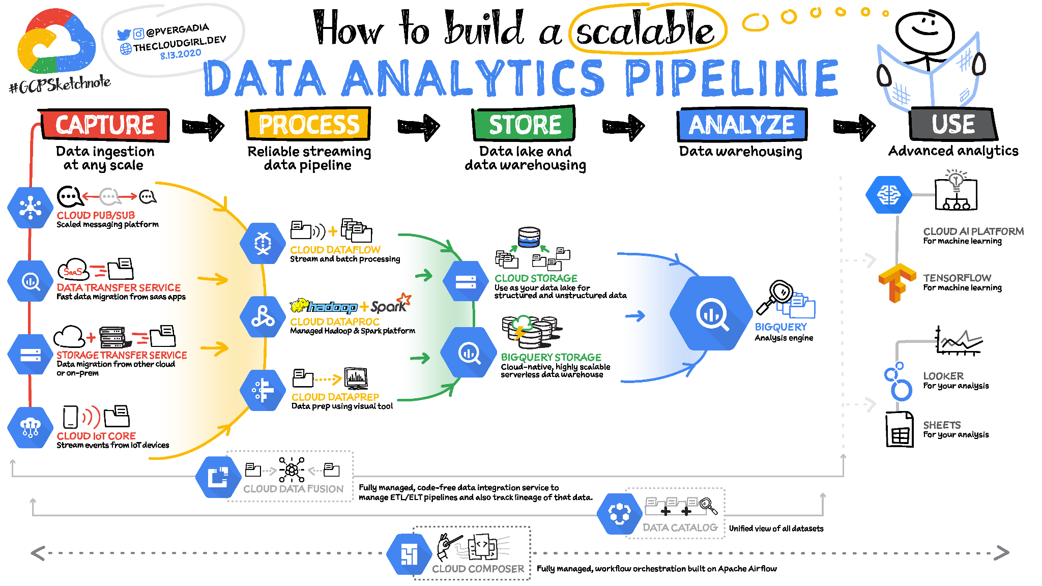
Collection (advanced)
Whole careers are built in the collection - storage phase.
Always be in sync with your data engineers.
https://www.freecodecamp.org/news/scalable-data-analytics-pipeline/

Slide 29
MILESTONES: Storage
Location
Local
On prem Server
Cloud
Format
Flat Files ie. CSV, Excel
Binary
Database
Retention
How long do we keep it?
How much do we keep?
How recent are refreshes?
Security
Who can access the data?
Is the data encrypted?
Do we backup?

Slide 30
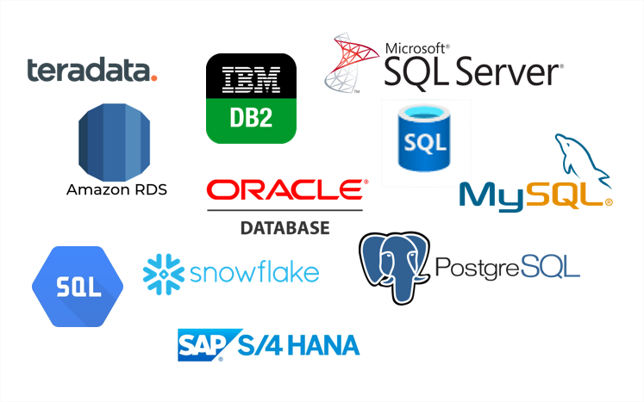
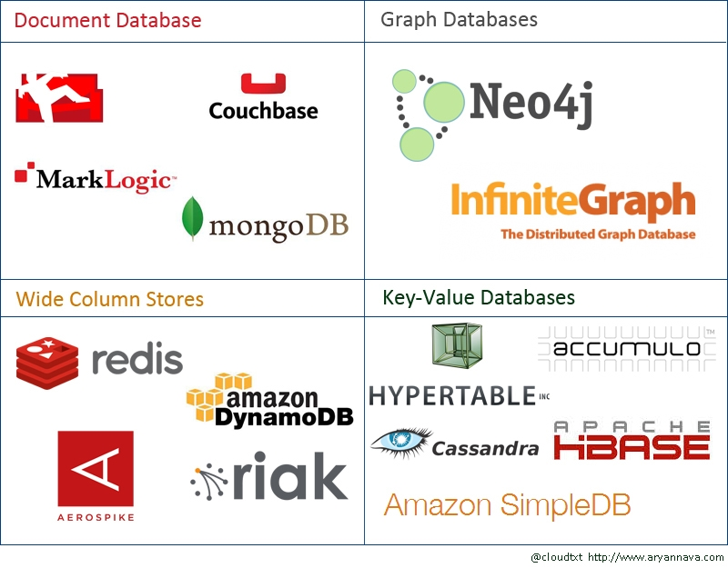
Storage (advanced)
Relational databases are well-structured and suited for medium to large sizes of data (terabytes, max)
NoSQL databases have looser structure and are suited for planet-sized data (petabyes and beyond)
No matter the type of database, SQL is used or a mindset very similar to it.

Slide 31
MILESTONES: Quality
Clean data is usable data
Take the example of an online bookstore:
Duplicate transactions
Misspelled authors
Outdated promo codes
Missing publication year
CSRs type different date formats in shipping returns
Comment fields contain social security #s
Purchase date happened after shipping date
What queries would you do for these?

Slide 32
Quality (advanced)
Implementing business rules is a key part of quality
Example: Summing up sales figures for audit and reporting
For accuracy, the correct joins need to be defined
Item
price
Bundle
price
Transaction
amount
Promo
rate
Returns
How?
SalesSummary

Slide 33
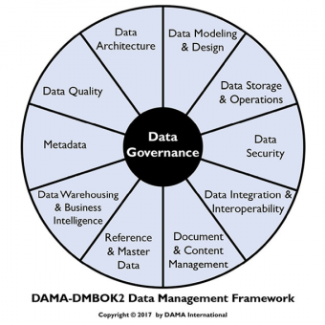
MILESTONES: Governance
It is a framework of processes, policies, metrics, and stakeholders that manage the organization’s data assets.
https://tdan.com/the-data-centric-revolution-semantics-and-the-dama-wheel/25576

Slide 34
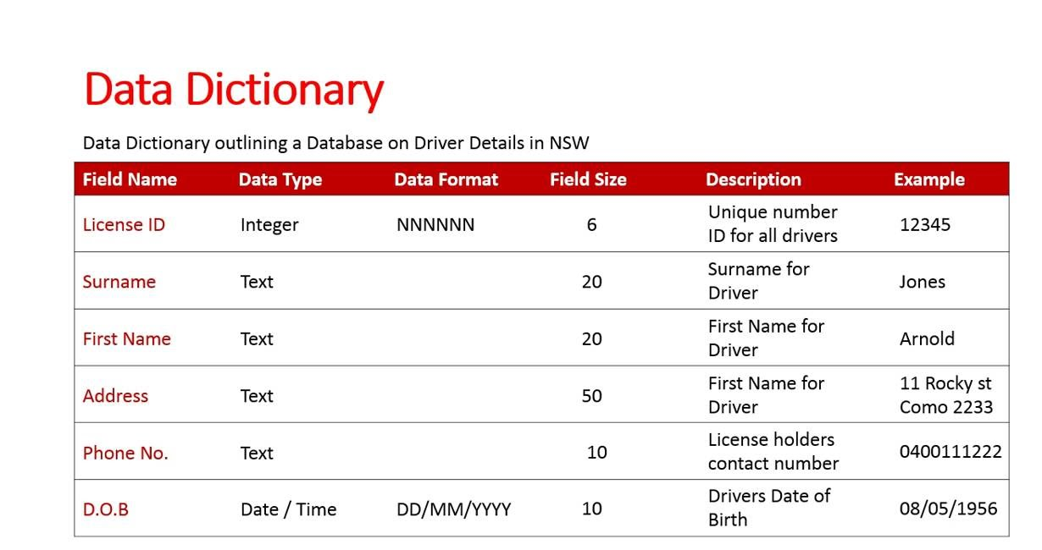
MILESTONES: Governance
Ensure your organization has a data dictionary, updated regularly and with sufficient information.
https://www.youtube.com/watch?v=kH0bcw9P2Lc&ab_channel=ChristopherKalodikis
Notes:
I’ve had an opportunity to jumpstart a data governance practice in a previous role. A data dictionary is one of the first artifacts. Others are the KPIs, regular checks, and communication protocols.
Allow for co-teacher to elaborate:
Back in day 1, there’s a slide on “No reliable info, no insighting.” How can a data dictionary support a project, in daily work?

Slide 35
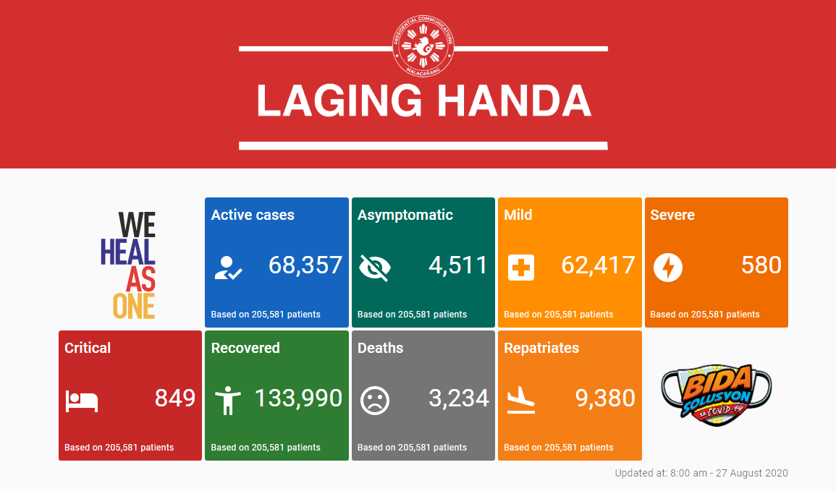
MILESTONES: Consumption
How do we share the data so people can use it?
Centralized Internal Database
Secure API over Internet
Restricted network drives
Password protected files
Business Intelligence / Reporting
Dashboards
Archiving
Legal

Slide 36
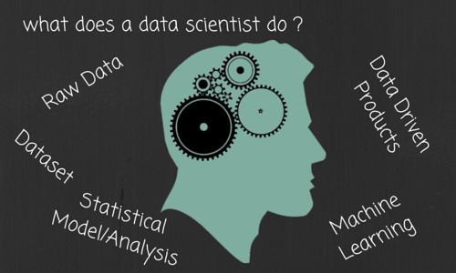
MILESTONES: Consumption
Can the data do more?
This is where YOU come in!
What tools can we use on the data? Ie. R, Python, SAS, Java, Tableau, PowerBI, etc.
What new insights / knowledge can be generated?
Can your discoveries address business problems and generate value?
Notes:
Speaking of data scientists, let’s segue to the roles in the data science world and where YOU can come in.

Slide 37





Roles (advanced)
Data Science is a Team Sport
Data scientists are now specializing in different dimensions.
Data Engineer
I collect, generate, and maintain the mountain of data.
Data Analyst
I find valuable minerals in the data. And share this on the daily!
Statistician
I determine which of the minerals are gold, and how best we can productize it.
ML Engineer
I create a way to develop and distribute the golden products efficiently.
Recommended Reading:
https://towardsdatascience.com/data-sciences-most-misunderstood-hero-2705da366f40

Slide 38
Roles (advanced)
Data Science is a Team Sport
Data scientists are now specializing in different dimensions.
Data Engineer
Manages the data so the organization can utilize its full potential
Favored tool: Databases
Data Analyst
Quickly identifies value worth pulling the rest of the crowd for
Favored tool: Data viz
Statistician
Creates the best certainties in a palette of uncertainties
Favored tool: Inferential stat
ML Engineer
Manages, deploys, and sustains models in production
Favored tool:
Good code

Slide 39
MILESTONES: Summary
Data should continuously generate value.
Strive for a sustainable data culture
Collection
Storage
Quality
Governance
Consumption
From "How Do Apples Grow" by Jill McDonald

Slide 40
DATA MGMT MILESTONES
With a chosen vertical, create a canvass / mindmap of the ff:
national healthcare system
ridesharing app
toy manufacturer
online course provider
✖Brainstorm a dashboard / ML model. Be sure your value proposition is solid.
✖What kind of data do you need? Where can it be found?
✖What are potential problems/ challenges to these data? ie.
cleanliness, data privacy, formatting, nulls
✖What treatments do you think should be done to the data to
make it more usable ie. transformation/aggregation
In other words, answer this question: What do you need, data-wise,
to be able to start working on your analytics project?
Each group to present their results in a simple deck
15 minutes prep, 5 minute presentation

